Slide 1


Submission type: Group 10
Batch: Batch 12
Program :Axis Bank Fintech Batch 12
Date: 17/07/2023
Internal Guide: Albin Xavier
Mentor: Shiv Raj Karlekar
Submitted by:
Nitish Raj
Manisha Yadav
Apeksha Dhuttargaon

Slide 2

TABLE OF CONTENTS
INTRODUCTION
FUNCTIONALITIES
PROJECT OVERVIEW
ARCHITECTURE DESIGN
USER INTERFACE DESIGN
CONCLUSION
FUTURE WORK
REFERENCES
APPENDICES

Slide 3

INTRODUCTION
Welcome to
AXIS SARAL LEARNING MANAGEMENT PORTAL
Our vision for the AXIS SARAL Learning Management Portal is to create a culture of continuous development within our organization. We envision a platform that fosters collaboration, and empowers every employee to reach their full potential.

Slide 4


PROJECT OVERVIEW
The AXIS SARAL Portal is a comprehensive and centralized platform that serves as the backbone of our organization, providing employees with easy access to essential information and enhancing overall operational efficiency. This project aims to streamline communication, improve collaboration, and empower employees with valuable resources to excel in their roles.

Slide 5


FUNCTIONALITIES
FUNCTIONALITIES :
ADMIN, can
Register New Employee
Update Existing Employee Details
Deactivate Employees
Add new Project.
Add new Stakeholder

Slide 6

FUNCTIONALITIES
EMPLOYEES, can
Access important company documents, including policies
View information about other employees, their current projects, managers, email, and phone numbers.
Download important documents like appointment letters, and increment letters.
Stay updated with recent activities, major project implementations, and organizational initiatives.
Create New Post
Provide comments on new or existing posts.
Access crucial information about important live projects:
Stakeholders involved, including their profiles.
Application owners, module-wise
Support team members and their profiles.
Job opportunities available within each project/team.
Receive Email, whenever a new post will be posted.

Slide 7




BACKEND DEVELOPMENT
JAVA 8
MySQL 8
Spring Boot
JPA
Eureka

Slide 8



FRONTEND DEVELOPMENT
React JS
Bootstrap
CSS
HTML

Slide 9

ARCHITECTURE DESIGN
FRONTEND
API GATEWAY
Api Path – “9999/”
Project Service
Api Path – “9091/ms1”
Employee Service
Api Path – “9092/ms2”
Job Service
Api Path – “9093/ms3”
Newsfeed Service
Api Path – “9094/ms4”
MySQL

Slide 10
USER INTERFACE DESIGN
EMPLOYEES
ADD EMPLOYEE
Admin
Dashboard
DEACTIVATE EMPLOYEE
LOGOUT
Invalid Credentials
PROJECTS
Invalid
ADD PROJECT
STAKEHOLDERS
Valid
ADD STAKEHOLDER
Input Email and Password
VALIDATE
START
Admin
NEWSFEED
View Post
Comment
Post
Employee
ORGANIZATION
View Employee Details
Search Employee
Input Email and Password
VALIDATE
Employee Dashboard
PROJECT
View Project Details
LOGOUT
Valid
SERVICES
View Service Details
Invalid Credentials
Invalid
DOCUMENTS
View/Download Documents
PROFILE
View Personal Details
View /Download Personal Details

Slide 11
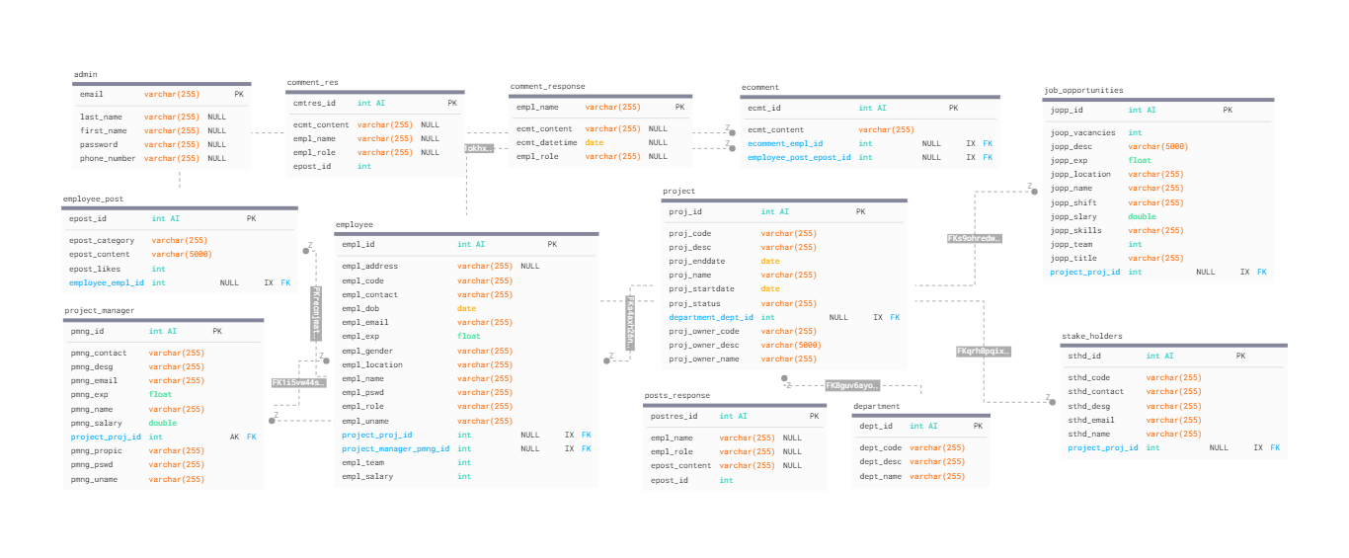
DATABASE DESIGN

Slide 12

TESTING
1.POSTMAN :
Postman is used to test or verify the functioning of Rest API’s.
Postman is an application used for API testing. It is an HTTP client that tests HTTP requests, utilizing a graphical user interface, through which we obtain different types of responses that need to be subsequently validated.
Almost any functionality that could be needed by any developer is encapsulated in this tool. It is used by over 5 million developers every month to make their API development easy and simple.

Slide 13

CONCLUSION
The AXIS SARAL Portal helps us to perform excellence and organizational growth. This transformative project aims to cultivate a culture of efficiency, collaboration, and empowerment within our organization.
Key Takeaways:
With a centralized vital information, employees can effortlessly access policies, SOPs, and essential documents.
Here we have developed various functionalities so that employee can access them easily.
This helps the employees to obtain many features which are in the portal.
Our PORTAL mainly helps in the access of services provided by organization directly.
The employees can be informative on the real time projects in the organization.
Empowered with real-time updates, employees can make informed decisions and contribute to our collective success.
The portal fosters collaboration and knowledge-sharing, strengthening our bonds as a united team.

Slide 14

FUTURE WORK
As we celebrate our progress with the AXIS SARAL Portal, there are exciting opportunities ahead to make it even better. Here are some future plans and improvements:
Personalized Learning:
Tailoring learning content for each employee using smart technology to boost their development.
Better Insights:
Using data analysis to understand employee performance and find areas for improvement.
Listening to You:
Gathering feedback from employees to enhance the portal based on their needs.

Slide 15

REFERENCES
Spring Boot Official Documentation:
https://docs.spring.io/spring-boot/docs/current/reference/htmlsingle/
2. React.JS Official Documentation:
https://legacy.reactjs.org/docs/getting-started.html
3.Oracle Java Tutorial:
https://docs.oracle.com/en/java

Slide 16
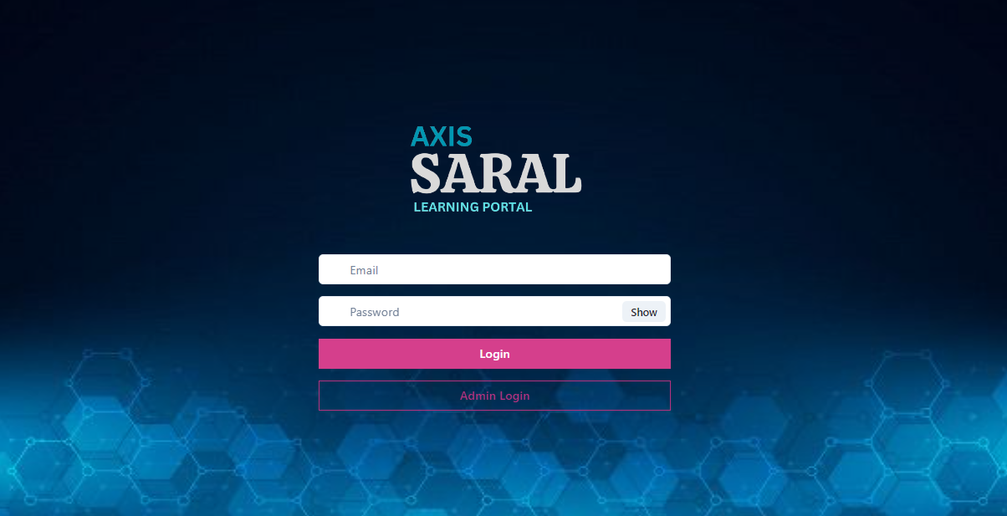
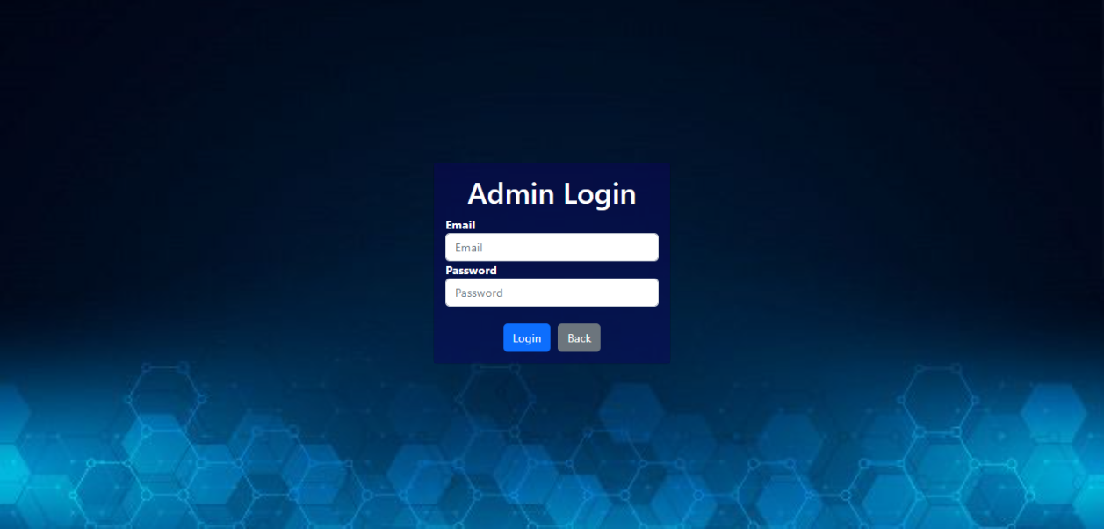
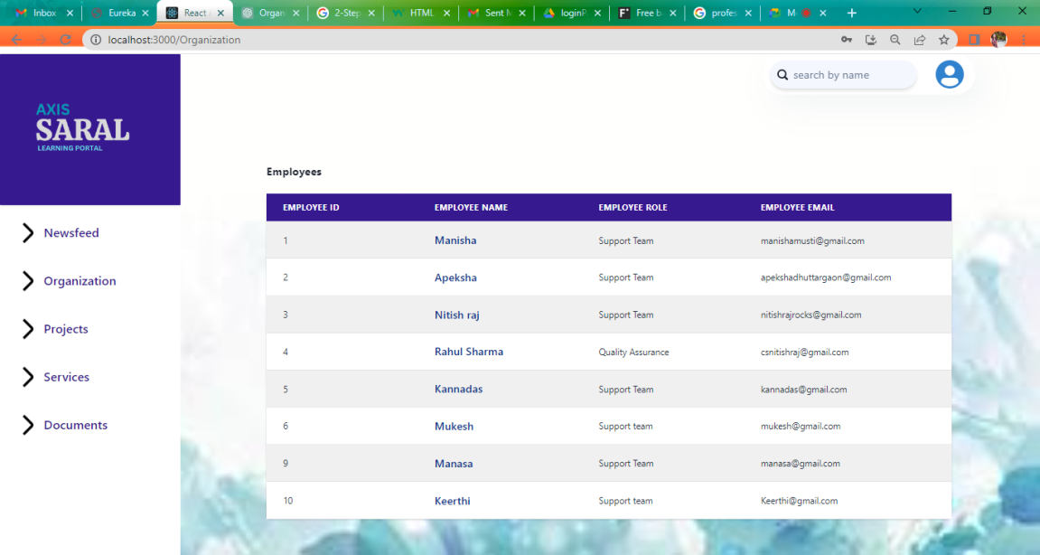
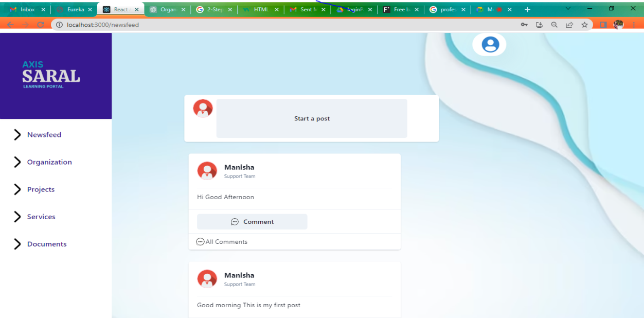
APPENDICES

Slide 17
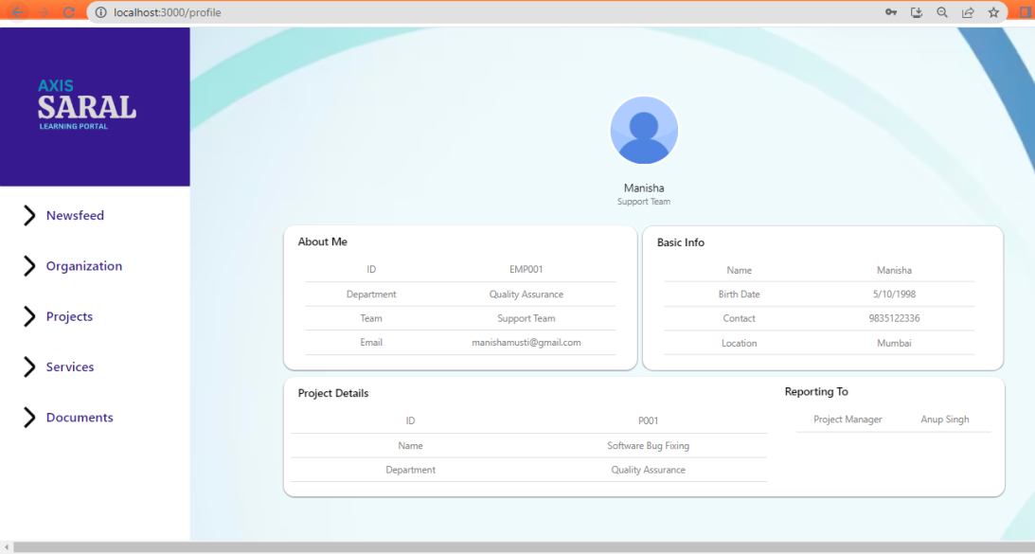
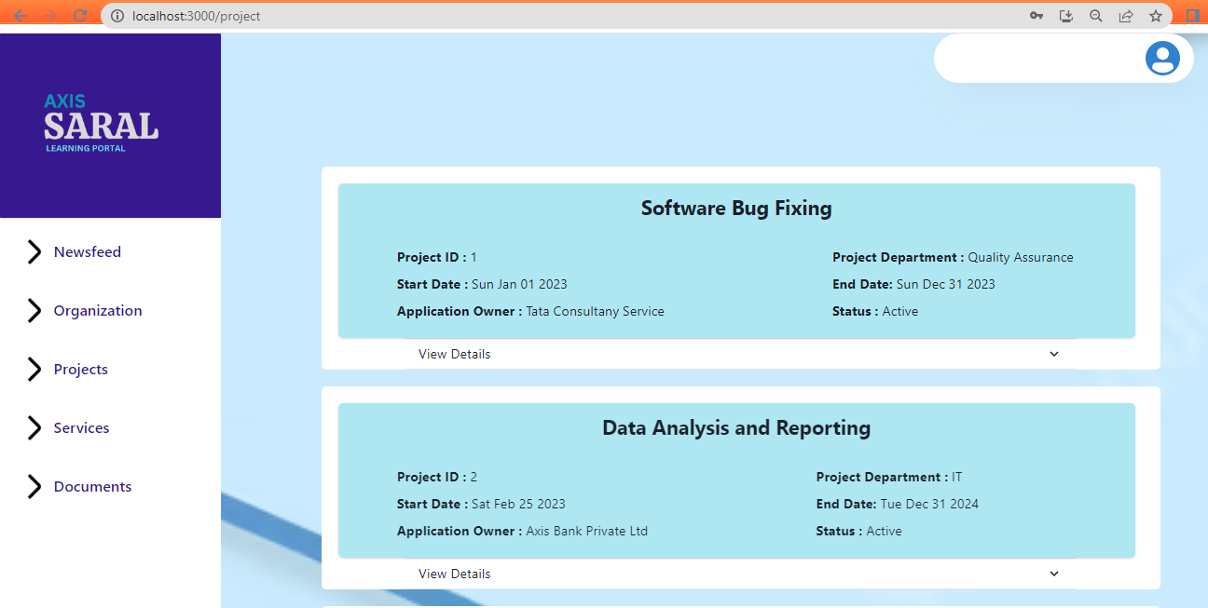
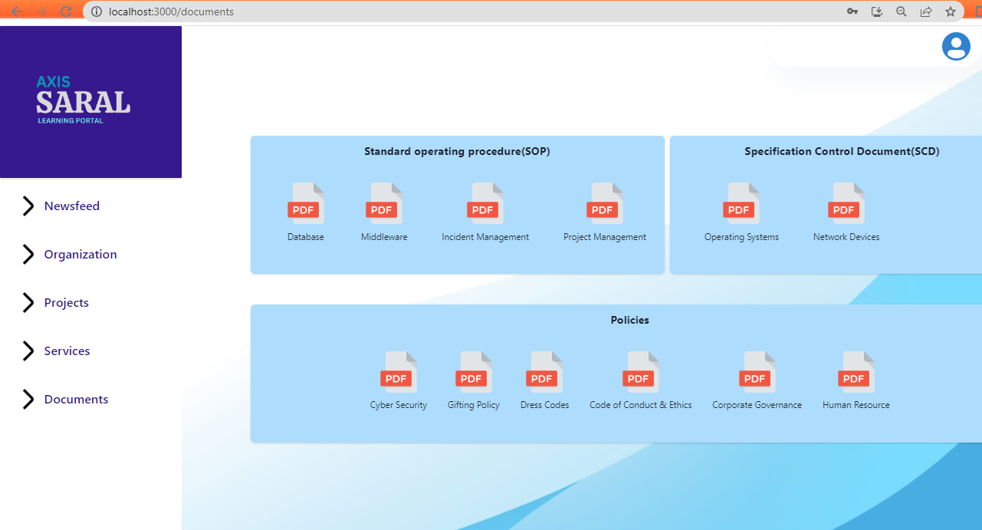
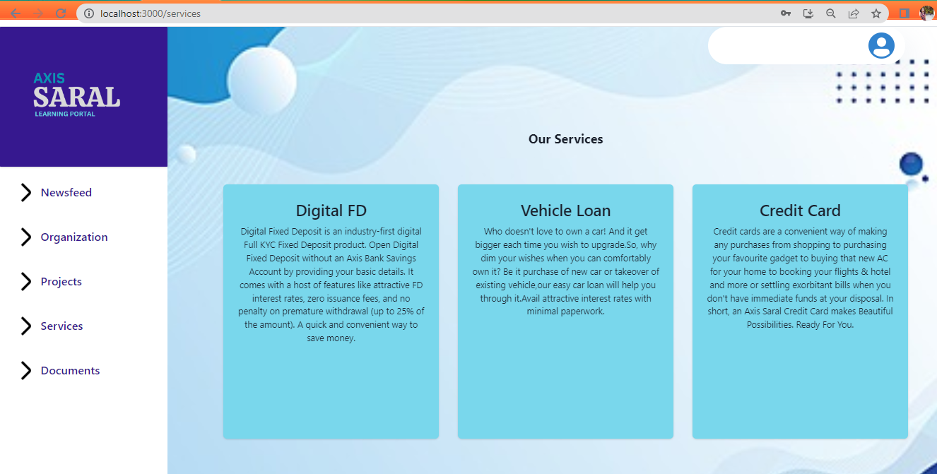
APPENDICES

Slide 18


